Slide 1


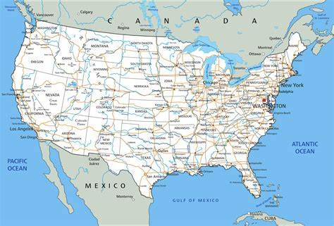
Standardized Test Analysis Where to establish a new learning center

Slide 2


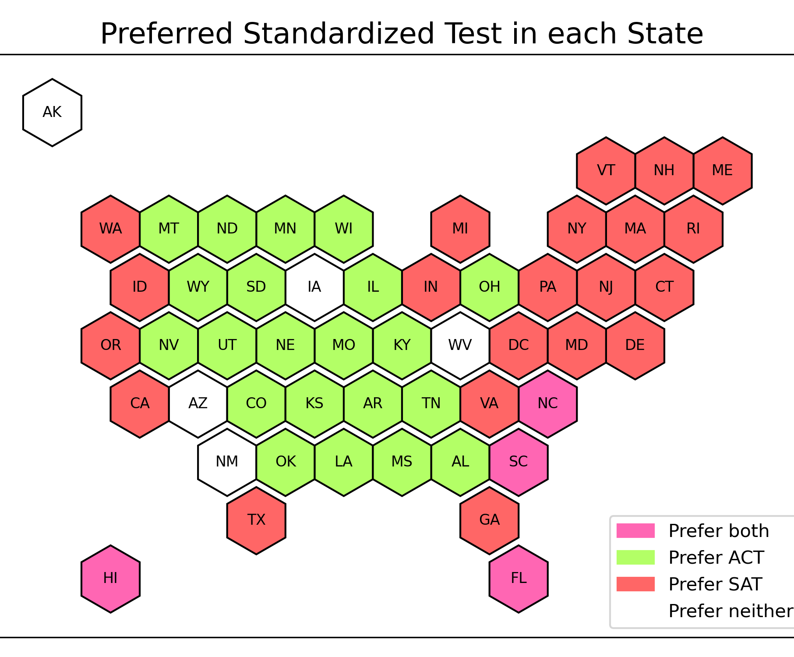
Problem statement
General Assembly Academy is planning to launch a new learning center focused on standardized test preparation, specifically the ACT and SAT. The goal is to identify the best states to establish the learning center and determine which subjects should be included in an intensive program.

Slide 3
Median ACT participation rates = 69%
Median SAT participation rates = 38%
There are four states—Hawaii, Florida, North Carolina, and South Carolina—that have participation rates greater than the median for both tests.
Notes:
2020, HI 1.4m, NC 10.4m, SC 5.1m, FL 21.5m

Slide 4
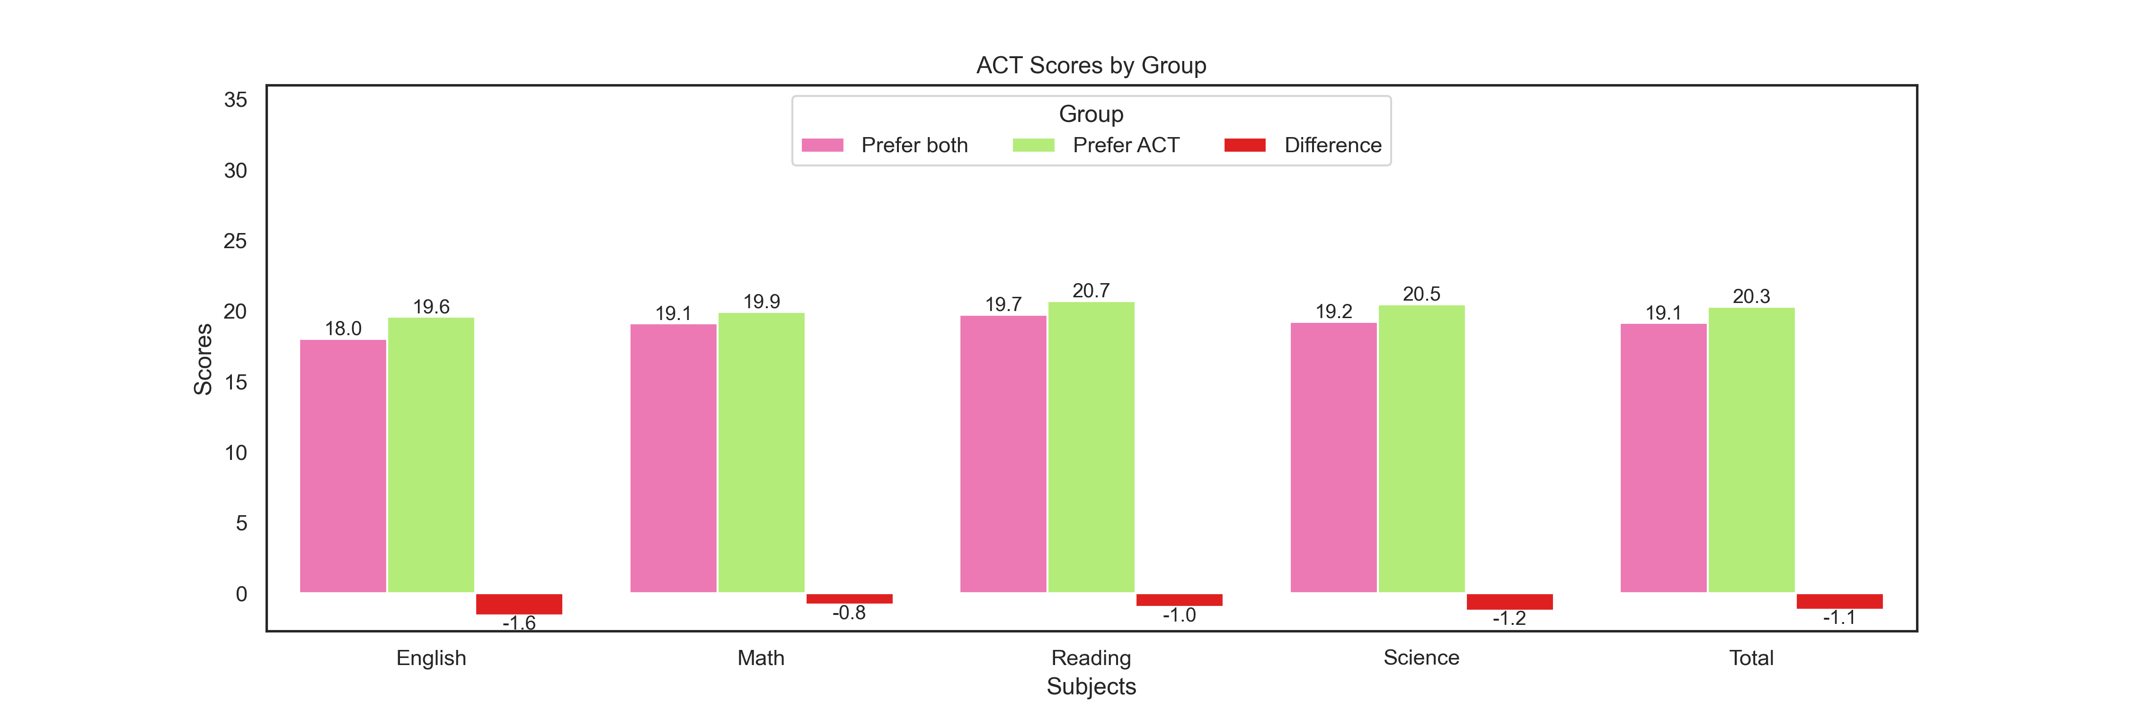
The average ACT score of those four states is 1.1 point lower than the states that prefer the ACT, mainly due to lower English scores

Slide 5
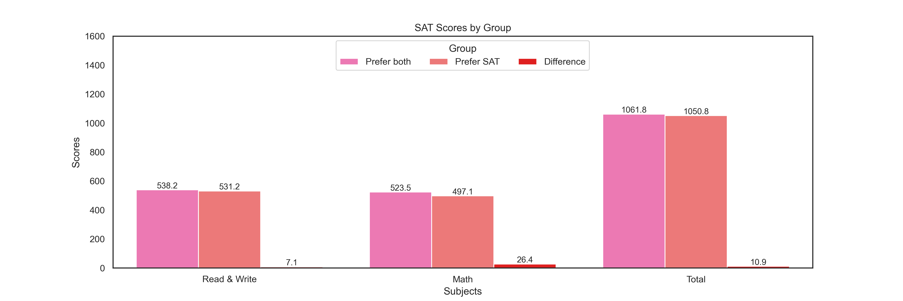
The average SAT score of those four states is 10.9 point higher than the states that prefer the SAT, mainly due to higher Math scores.
The Read & Write scores of those four states are only 7.1 higher than the states that prefer the SAT

Slide 6
conclusion
Suggest to establish the learning center at Hawaii, Florida, North Carolina, or South Carolina
For boost up the overall scores of those 4 states:
ACT – add English intensive programs
SAT – add Read & Write intensive programs

Slide 7


Thank you for your listening

